Slide 1
iSee
Accessible Gaze-Based Reading for the Phone
Beverly Yip | Josephine Odusanya | Yi Wang
Notes:
Hi, we’re iSee Group. Our project explores an eye-gaze control system from an assistive technology perspective, focusing on our main client, Jessica, who has limited upper-body mobility. I’m Yi, I’m responsible for interaction design. My partners Bev is for software development and Jo for hardware design.

Slide 2
Introduction
Eye-Gaze Tracking User Research
Eye-Gaze Tracking Physical Prototype
Eye-Gaze Tracking Browser Prototype
(Replace with Yi’s Section 2 Title)
Next Steps
AGENDA

Slide 3
Introduction

Slide 4
Eye-Gaze Tracking Research
P A R T 0 1
Product Research & User Research
Notes:
Here is our product research and user research

Slide 5
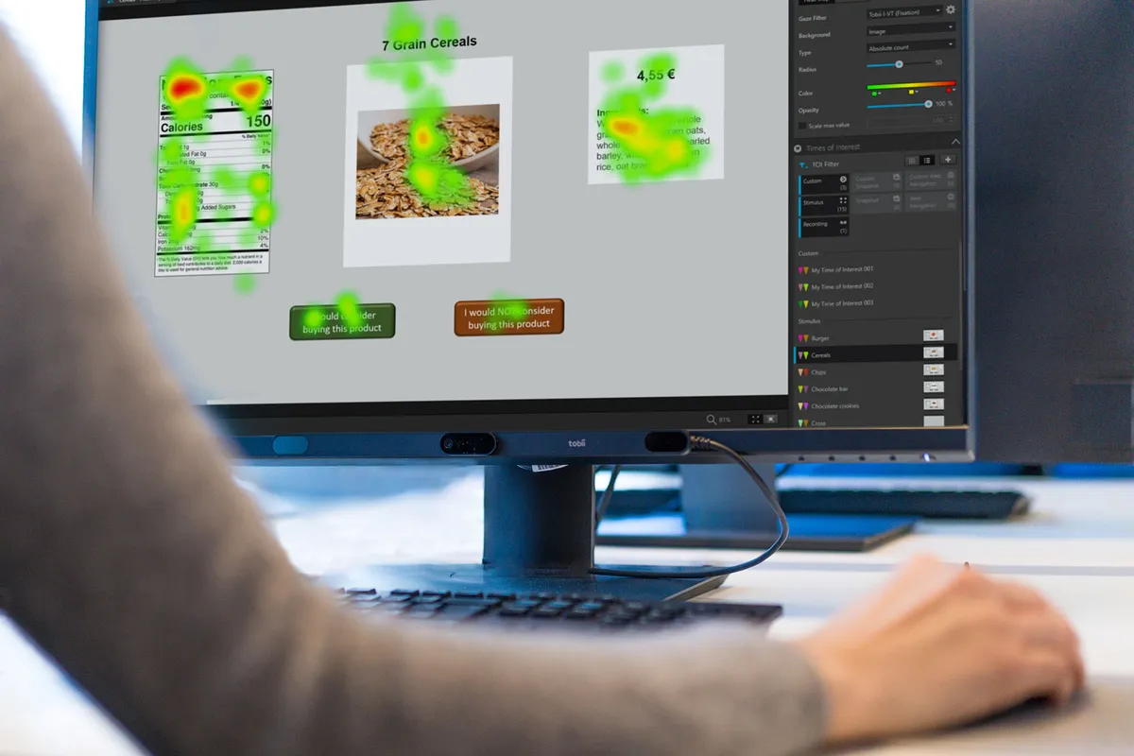
Eye Tracking System
Eye-Tracking Technology
Records where and how long a person looks using cameras that follow eye movements in real time.
In assistive contexts, allows users to control digital interfaces hands-free
Notes:
Eye-tracking technology records，where and how long a person looks using cameras that follow eye movements in real time. In assistive contexts, this allows users like Jessica to control digital interfaces hands-free, promoting independence and accessibility in daily life. The image shows a person using a Tobii eye-tracking system on a computer monitor. The screen displays a product comparison interface with a green-to-red heat map overlay showing where the user’s gaze is focused. Tobii eye tracker is mounted below the monitor, connected by a USB cable.

Slide 6
Competitive Analysis
Eye-Gaze Tracking Research
Tobii
PCEye
Industry leader in assistive communication; accurate gaze control; integrates with AAC software
Expensive; limited outdoor performance; bulky setup
Portable eye tracker for Windows; plug-and-play usability
Needs controlled lighting; not optimized for facial occlusion or glasses
more…
Smart Eye, Varjo, Novasight, Omnivision, iMotions
Notes:
We analyzed existing eye-tracking systems such as Tobii and PCEye . Most provide reliable gaze control, but they struggle with outdoor lighting, precise calibration, and user comfort.

Slide 7
User Journey & User Flow
Eye-Gaze Tracking Research
Notes:
We created user journey and workflow maps to understand Jessica’s real-world experience with the Tobii eye tracker.

Slide 8
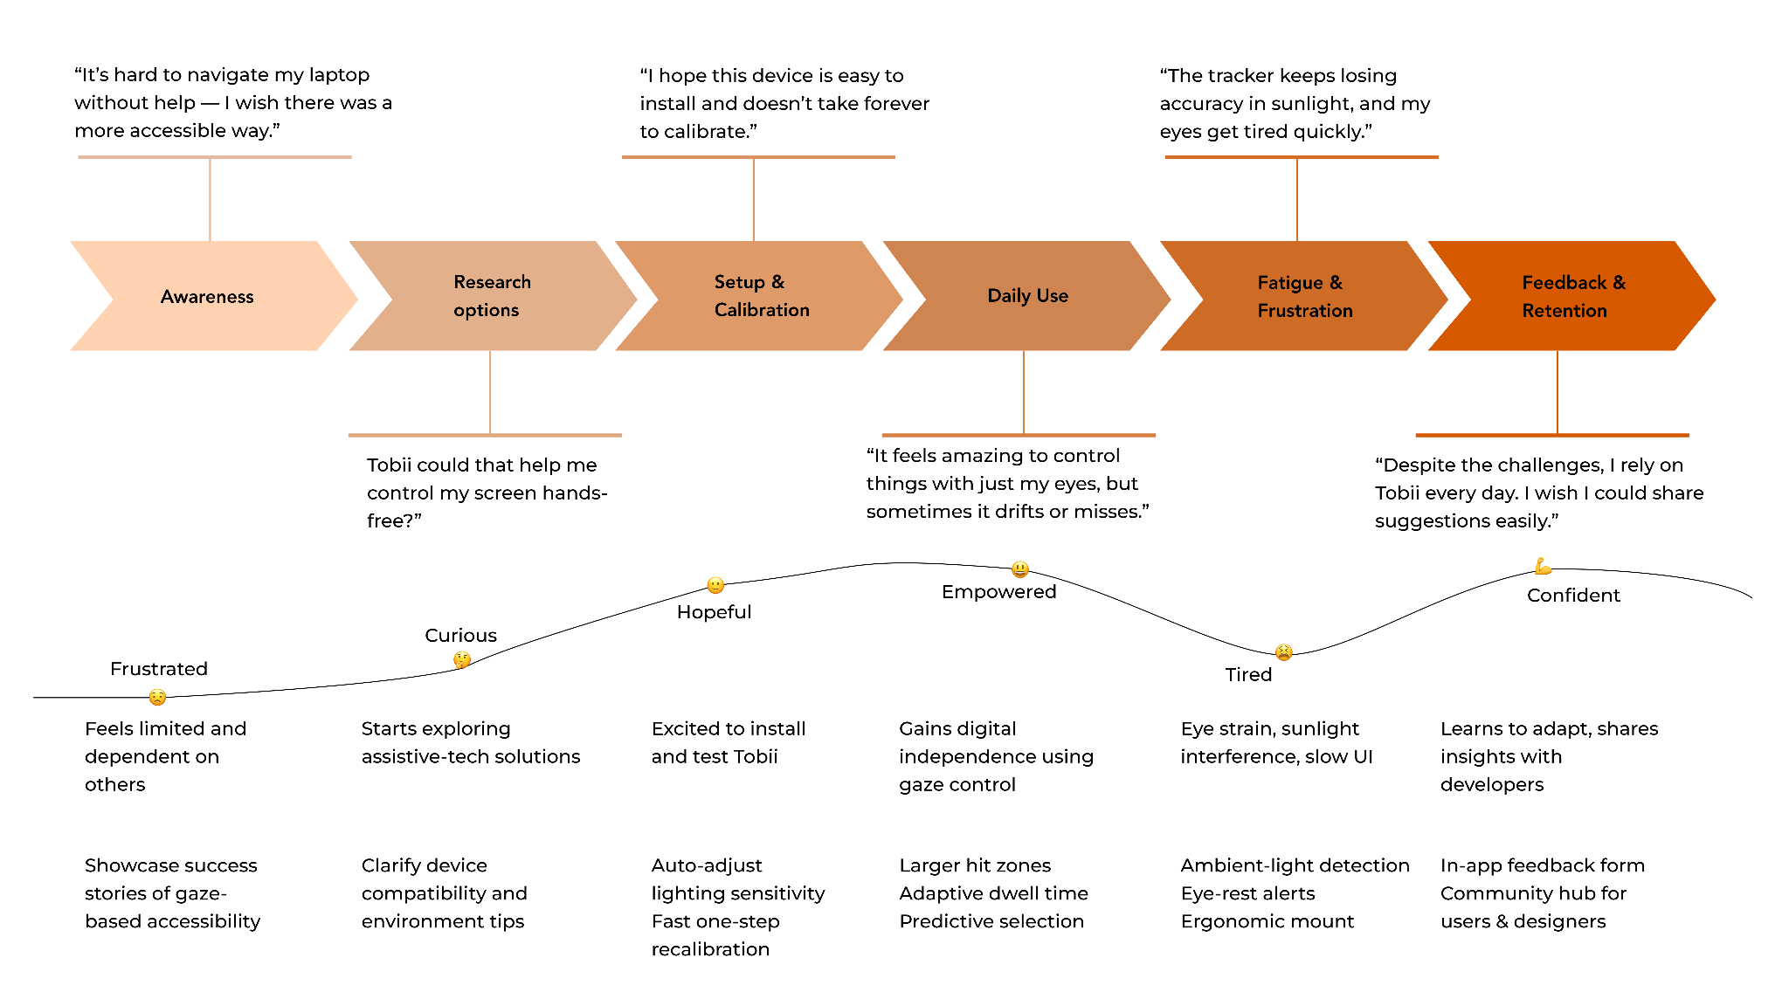
User Journey Map
Eye-Gaze Tracking Research
https://drive.google.com/file/d/13Cg47QD0V3WfF1XWmSkcrzrulWYf813K/view?usp=share_link
Notes:
This is a horizontal user journey map for Jessica using eye tracker. It shows six stages while using the tech includes feelings, actions, and design opportunities for improvement. You can use the link on the slide to explore the full details.

Slide 9
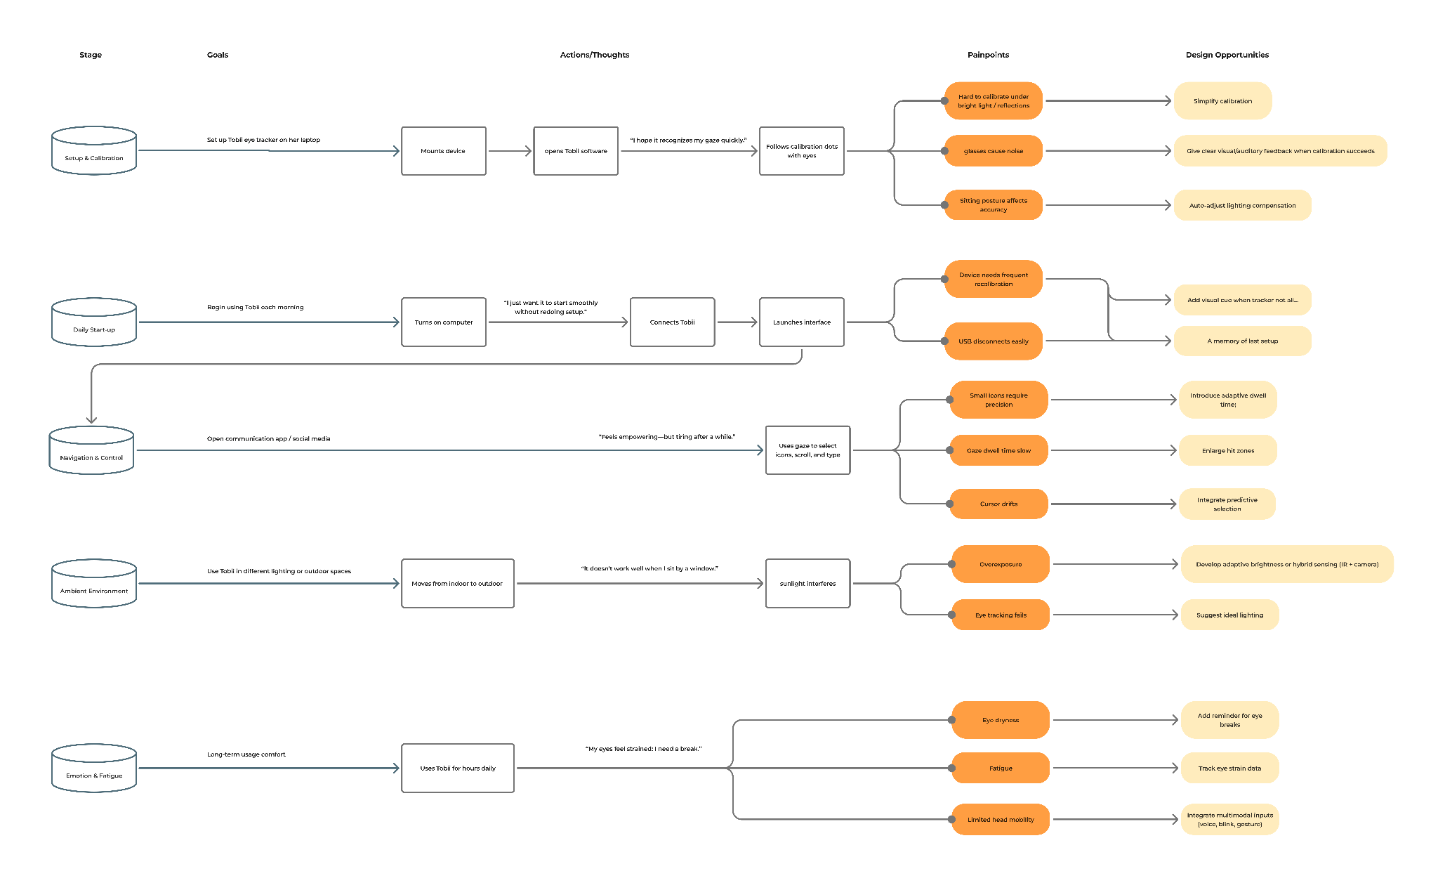
User Flow
Eye-Gaze Tracking Research
https://drive.google.com/file/d/1JywPjYTmN9Qp1dKd3ZLmJ8irhMCbAY1-/view?usp=share_link
Notes:
This is a user flow mapping Jessica’s interaction with the Eye Tracker in six stages. Link on the slide to explore the full maps in detail.

Slide 10
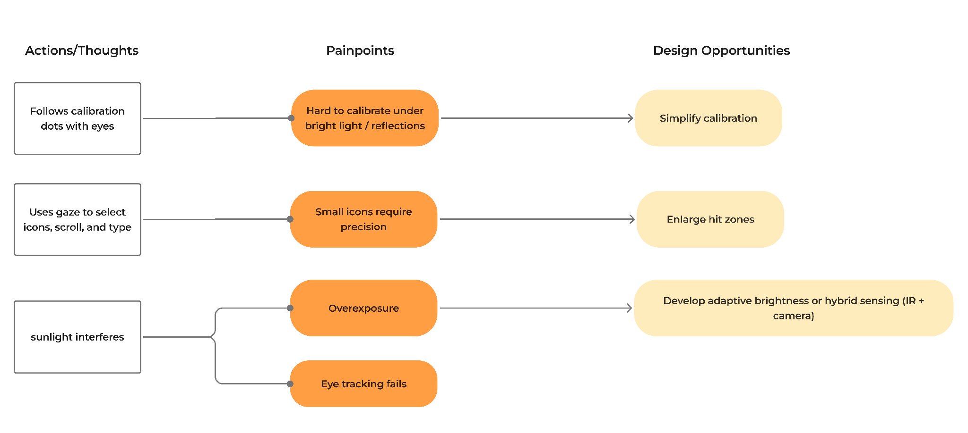
Detailed User Flow
Eye-Gaze Tracking Research
Notes:
It’s a detailed user map with pain point we will focus on. On sunlight interference with developing adaptive brightness. On small icons which require high precision such as enlarge hit zones.

Slide 11
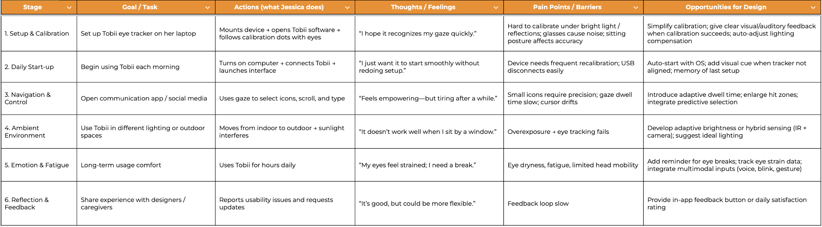
User Flow Chart
Eye-Gaze Tracking Research
https://docs.google.com/spreadsheets/d/1g3sdaboAe8moYrInqIJNachVf5u1fkw0G95fyL4R-Rg/edit?usp=sharing
Notes:
This is a chart show key moments from setup to daily use. Please use the link on the slide to explore the details too. These are our current product and user research. I’m going to pass it to Jo for prototypes of hardware.

Slide 12
Prototypes

Slide 13
Eye-Gaze Tracking Physical Prototype
P A R T 0 2
The Hardware

Slide 14
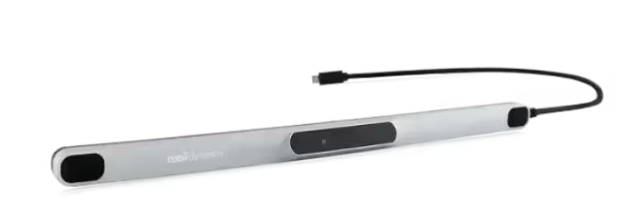
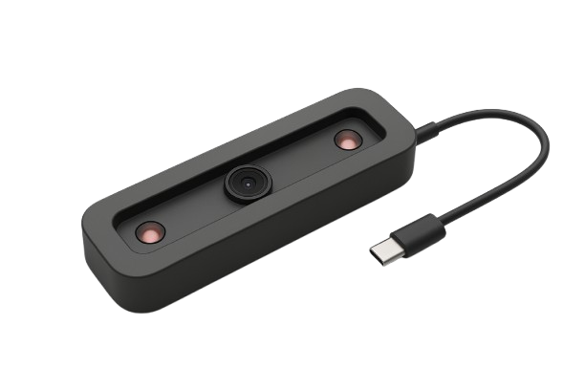
What We Have
EYE-GAZE TRACKING PHYSICAL PROTOTYPE
Our community Partner Jessica has told us of her concerns: she has been using the Tobii PCEye® Tracker for years but recently tried a phone-based eye-tracker. To summarise, it was not a pleasant experience.
Notes:
We decided to build a dedicated hardware design instead of relying only on iPhone software because it gives us more control over accuracy and usability. The built-in phone cameras aren’t optimized for eye tracking, especially in bright or variable lighting. With our hardware, we can add infrared illumination, better optics, and design for multiple devices — making the system more flexible and reliable for low-vision users.

Slide 15
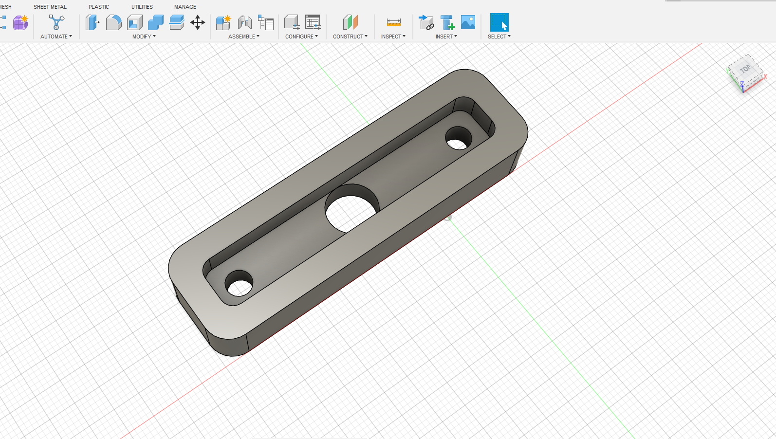
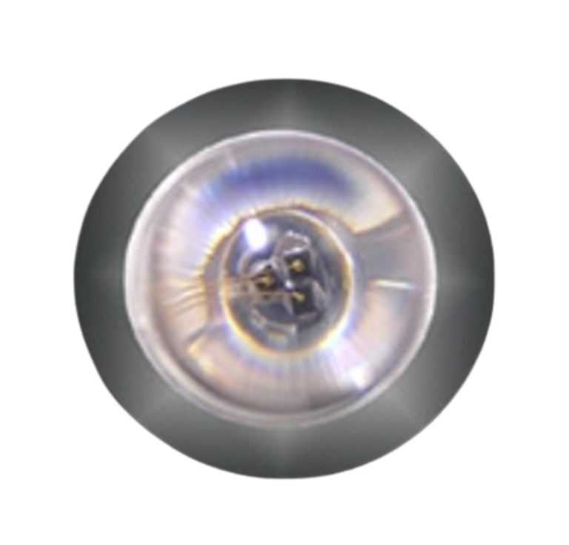
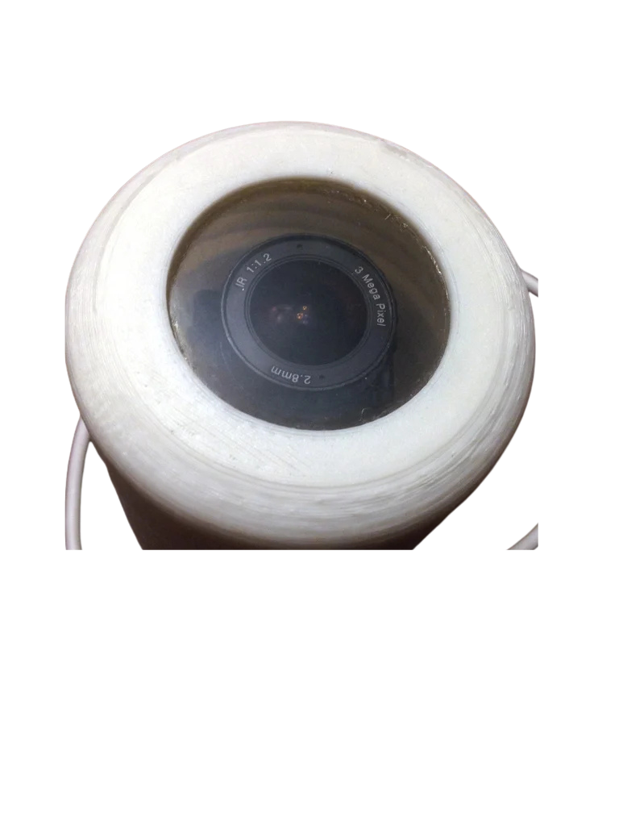
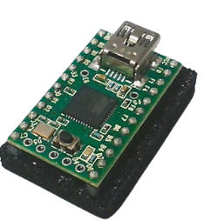
CAD model
EYE-GAZE TRACKING PHYSICAL PROTOTYPE
IR LEDs
Mini microcontroller (underneath)
MINI Camera
WIP
Notes:
“The first step was creating a parametric CAD model in Fusion 360.
The design follows a structured workflow — with sketches, constraints, and key parameters defined for easy adjustments.
This approach allows us to modify dimensions — such as camera diameter or wall thickness — without redrawing the entire part.
Here, you can see the base geometry that supports the small camera module and IR LED components.

Slide 16
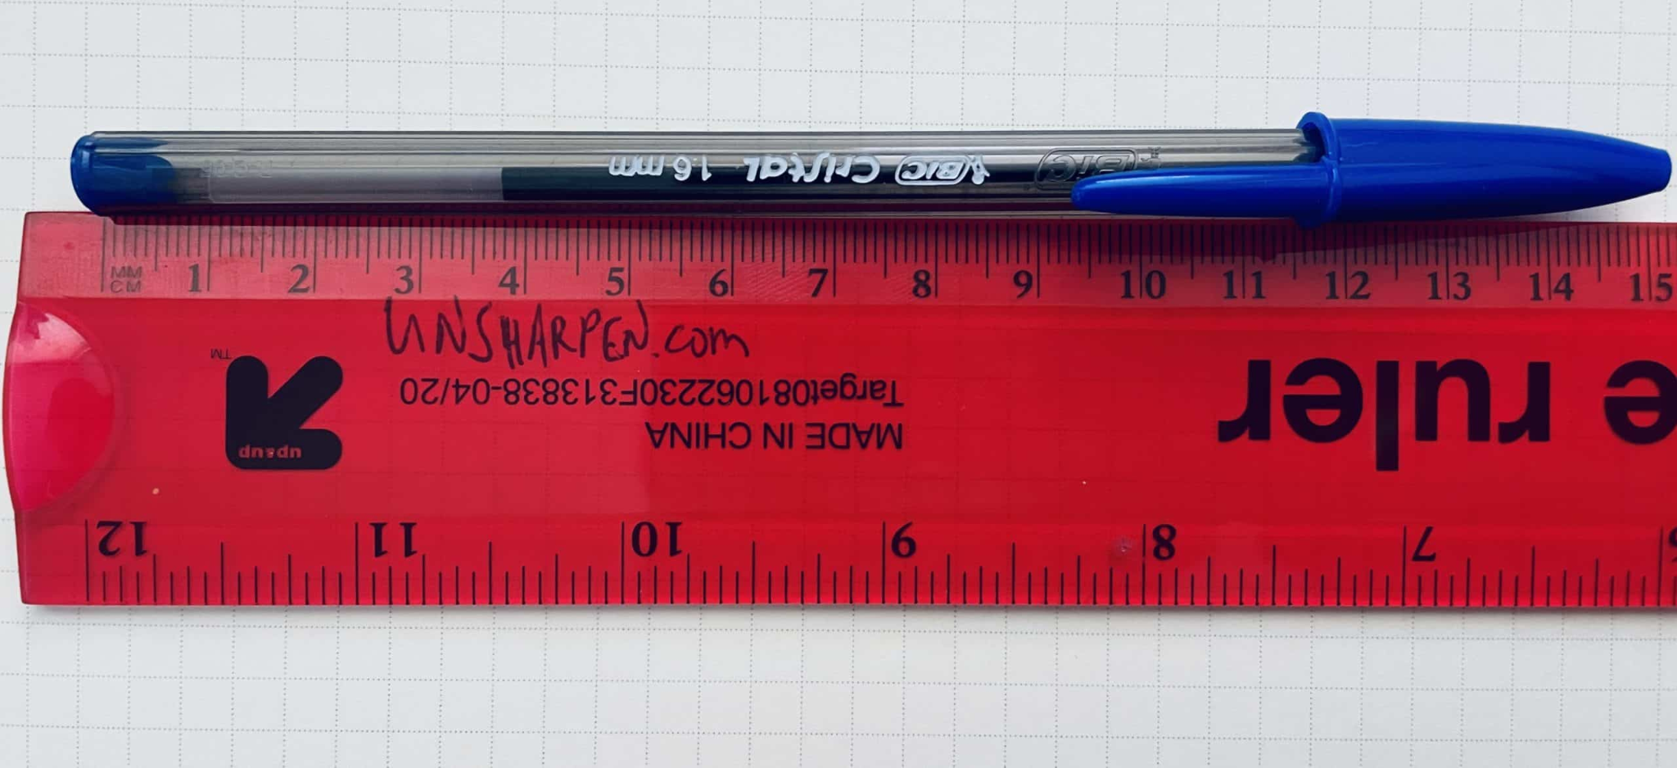
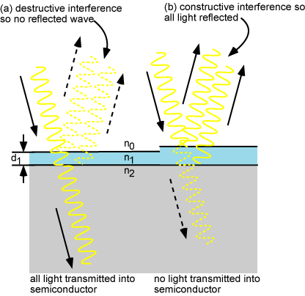
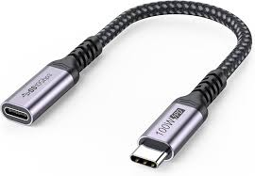
What We Want
EYE-GAZE TRACKING PHYSICAL PROTOTYPE
0 1 . Smaller design
Redesigned the hardware into a compact, pen-sized form factor, reducing bulk while maintaining camera alignment and stability for eye tracking.
0 3 . Anti-Reflective coating
Incorporates a thin optical layer to reduce glare and improve pupil detection accuracy in bright or outdoor environments.
0 2 . Multi-device compatible
Uses a USB-C connection for seamless pairing with smartphones and tablets, enabling cross-platform eye-tracking without a PC.
Notes:
The pen body includes:
• A central camera mount for the USB micro camera module.
• Two side apertures for infrared LEDs that provide pupil illumination.
• Screw holes and recesses for structural attachment and easy assembly.
• Cable routing channels for power and data lines connected via USB-C OTG. Quality control steps will include checking tolerances for press fits and ensuring consistent hole diameters using digital calipers or gauge pins after printing.”

Slide 17
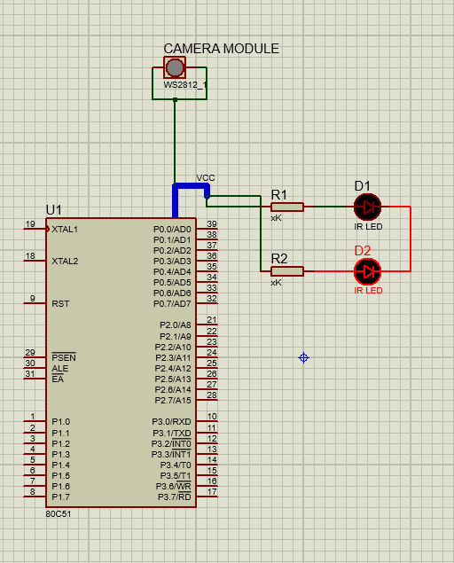
Electrical Design
EYE-GAZE TRACKING PHYSICAL PROTOTYPE
The electronic subsystem consists of three main parts:
A UVC USB micro-camera for real-time eye imaging.
Two IR LEDs positioned symmetrically around the lens for pupil illumination.
A USB-C OTG connection to the phone, which supplies 5 V power and streams video frames for processing in an Android or iOS app.
A small boost-regulated LED driver circuit controls current to the IR LEDs, preventing overheating and ensuring uniform brightness.
Future versions could integrate an IMU for motion compensation or a microcontroller for preprocessing.

Slide 18
Cost Breakdown
EYE-GAZE TRACKING PHYSICAL PROTOTYPE
Item | Cost | Product link
Ultra Tiny Webcam Camera with GC0307 Sensor | $6.95 | Adafruit
IR LEDs | $5.98 | Amazon
Enclosure | $0 | Makerspace
Lens (M12 mount, 60° FOV) | $8.09 | Amazon
Microcontroller | $0
Total Cost | $18.02
Notes:
For early prototypes, we plan to use PLA or PETG through FDM 3D printing due to their ease of use and cost efficiency.
Later iterations could use ABS or nylon for better heat resistance and durability.
The small camera mount could also be resin-printed for tighter tolerances around the optics.
All components were designed with standard screw sizes and M2 inserts to ensure repeatable assembly.

Slide 19
Eye-Gaze Tracking Browser Prototype
P A R T 0 3
The Software

Slide 20
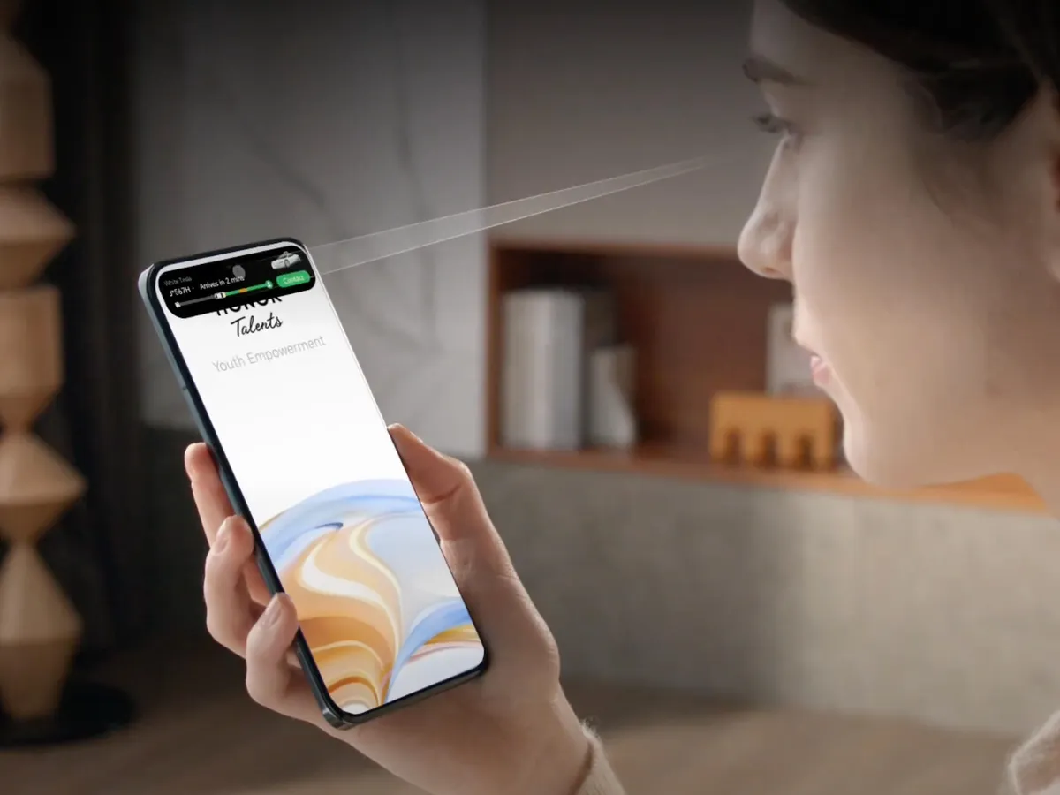
Context
EYE-TRACKING BROWSER PROTOTYPE
Accessibility Gap
Eye trackers like Tobii are powerful but physically large, expensive, and have limited mobile use.
The Goal
Mobile-accessible eye tracking user experience for Jessica.
Software Prototype
Browser-based, phone-ready gaze simulation.

Slide 21
Prototype Overview
EYE-TRACKING BROWSER PROTOTYPE
Camera Setup
Calibration
Main Interaction
Notes:
Link to the demos: https://drive.google.com/drive/folders/1e0b4raHe9yEjDXfhbO75VId3nGIrjUcv?usp=sharing

Slide 22
How It Works
EYE-TRACKING BROWSER PROTOTYPE
Webcam
Gaze Coordinates
Dwell Detection
Eye Landmarks
Smoothing
Feedback
WebGazer.js

Slide 23
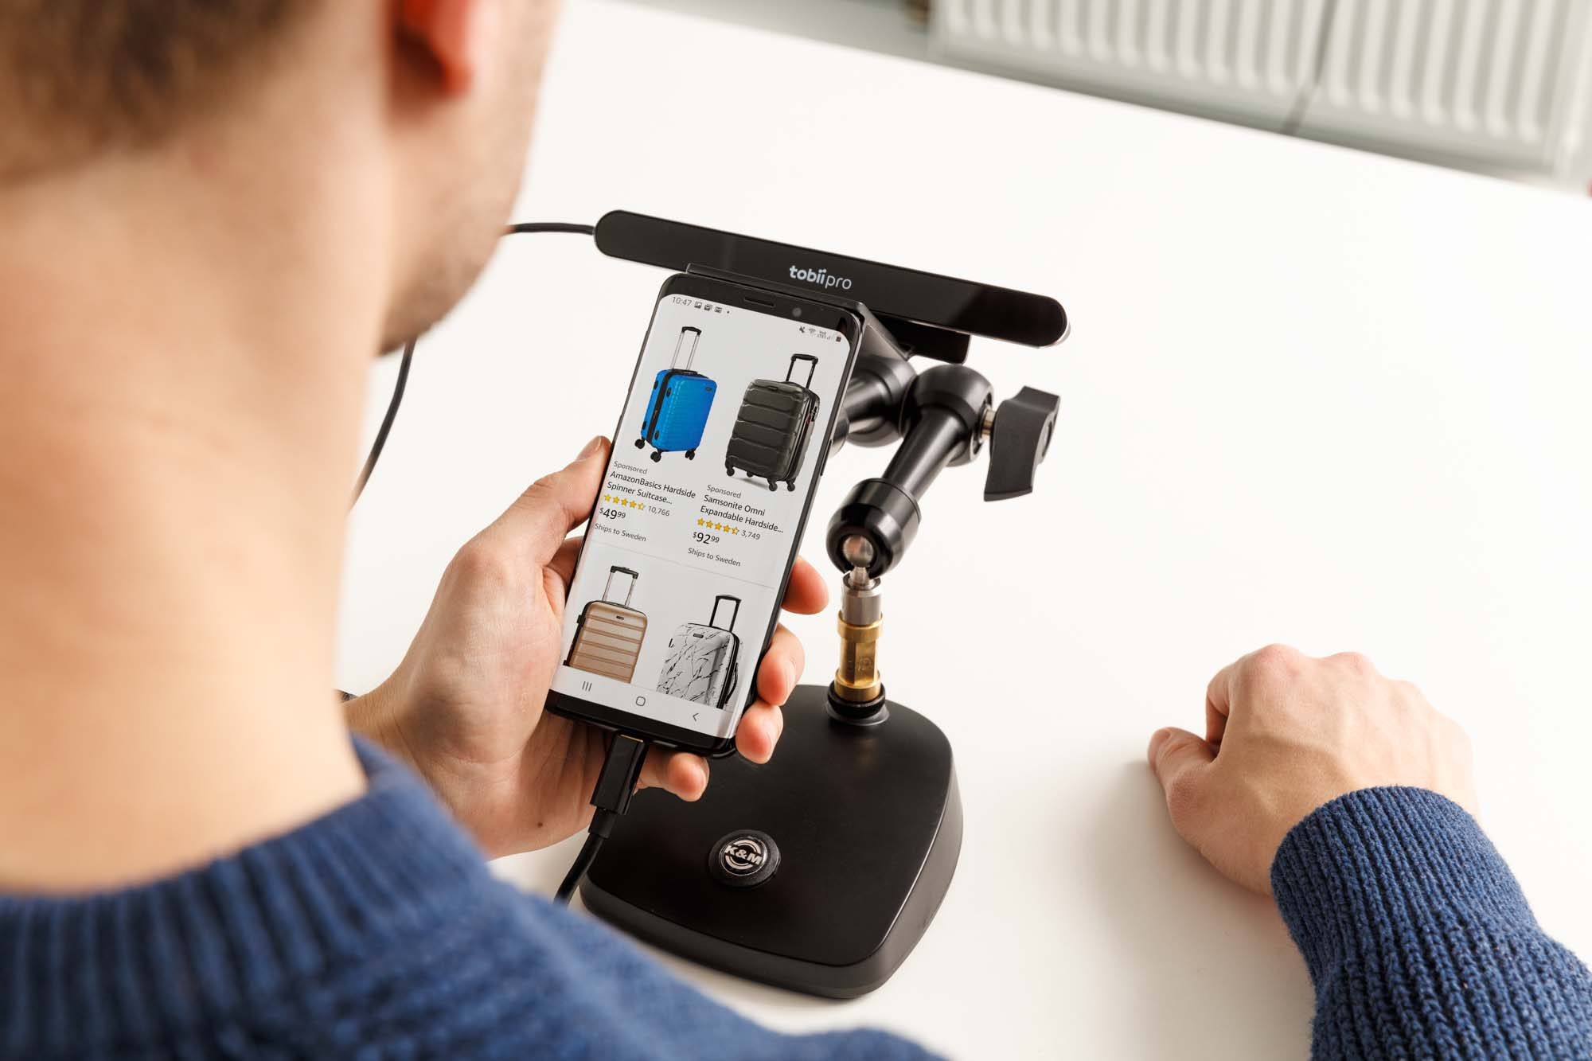
Feasibility & Next Steps
EYE-TRACKING BROWSER PROTOTYPE
Simulated: WebGazer.js proof-of-concept
Hardware Integration: ESP32 / OpenMV / Jetson for real eye-tracking
Next Steps:
Integrate prototype with hardware gaze stream
Optimize calibration & jitter reduction
User test mobile prototype

Slide 24
Project Goals
Notes:
Thanks for Jo and Bev for the insight of prototyping.

Slide 25
Our Goal
Project Goals
“Enhance comfort, accuracy, and adaptability of gaze interaction in real-world conditions.”
High Priority (Focus)
Sunlight interference — tracking fails in bright environments
Small icons — require high precision, cause gaze fatigue
Nice-to-Have Improvements
Reduce fatigue with eye-rest reminders
Auto-calibration for faster setup
Adaptive dwell time for smoother navigation
Notes:
So, our project goal is to enhance comfort, accuracy, and adaptability of gaze interaction in real-world conditions. We finalized the key pain points to focus on.
Our top priorities are improving sunlight adaptability, and interface usability, where small icons make gaze control difficult.
Additionally, we identified fatigue reduction, auto-calibration, and adaptive dwell time as nice-to-have improvements for comfort and long-term use. I’m going to pass it to Bev for our next steps.

Slide 26
Next Steps

Slide 27
Bridging Prototype to User Needs
NEXT STEPS
Software
🌞 → Test eye-tracking under harsh sunlight
📱 → Simulate gaze interaction with adjustable targets

Slide 28
Bridging Prototype to User Needs cont…
NEXT STEPS
Hardware
🤖 → Prototype Integration & Calibration
👤 → User Testing & Validation
Notes:
Combine camera, IR LEDs, and phone interface into a compact unit. Calibrate gaze tracking for accuracy under varied lighting. Test performance in sunlight and with simulated gaze interaction tasks. Refine software mapping and hardware alignment based on results.
We decided to build a dedicated hardware design instead of relying only on iPhone software because it gives us more control over accuracy and usability. The built-in phone cameras aren’t optimized for eye tracking, especially in bright or variable lighting. With our hardware, we can add infrared illumination, better optics, and design for multiple devices — making the system more flexible and reliable for low-vision users.”

Slide 29
Thank You

Slide 30
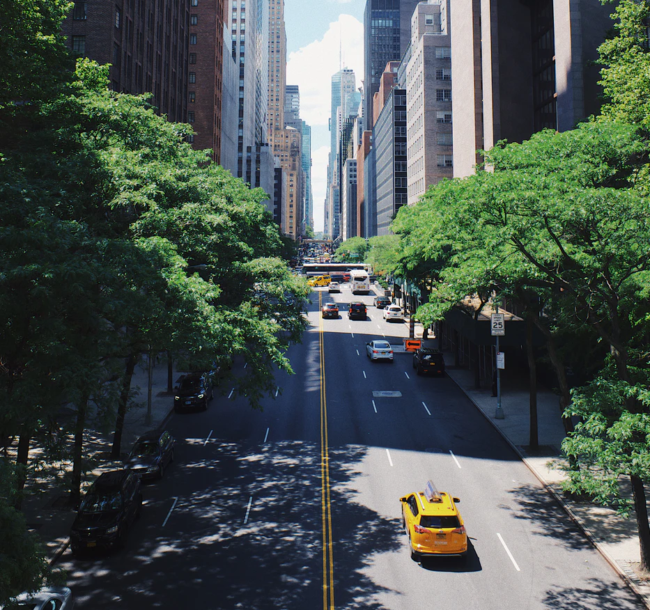
References
https://www.tobii.com
https://www.smarteye.se/
https://varjo.com
https://nova-sight.com/
https://www.ovt.com/
https://imotions.com/
https://grabcad.com/library/sony-imx258-camera-module-1
Khan MQ, Lee S. Gaze and Eye Tracking: Techniques and Applications in ADAS. Sensors (Basel). 2019 Dec 14;19(24):5540. doi: 10.3390/s19245540. PMID: 31847432; PMCID: PMC6960643.

Slide 31
An important quote can go on this page.
P A R T 0 1
John Doe, CEO

Slide 32
Template Notes
This template is part of the NYU Templates collection. Refer to our Usage Guidelines for help topics and quick tips on how to use this template.
Download the Grackle Slides add-on to automatically run accessibility checks on all aspects of your document and get advice on how to make things better.

